Slide 1
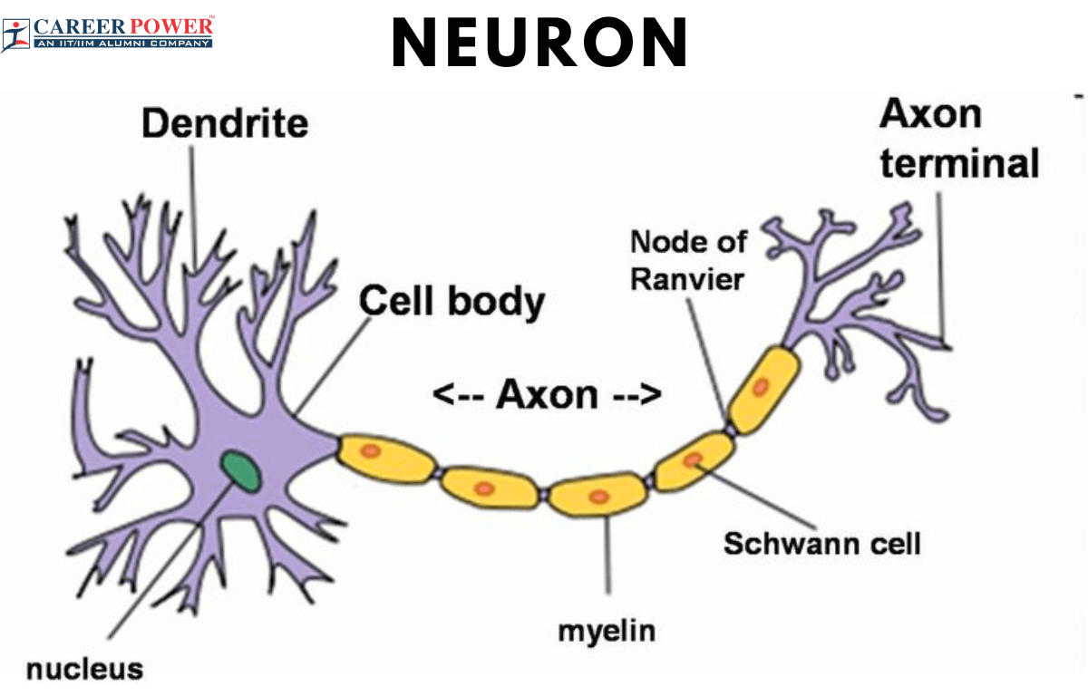
ARTIFICIAL NEURAL NETWORK [ANN]

Slide 2
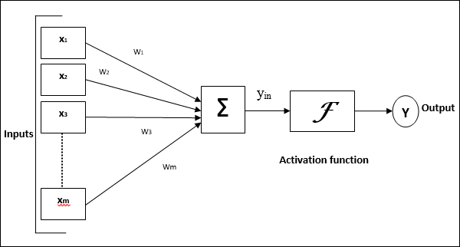
FAKE PROFILE DETECTION USING MACHINE LEARNING
TECHNICIAL NEURAL NETWORK.

Slide 3
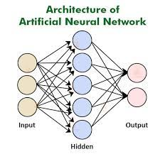
ARTIFICIAL NEURAL NETWORK

Slide 4
Neural networks are a fundamental concept in artificial intelligence and machine learning, inspired by the structure and function of the human brain. The architecture of a neural network refers to its organization or layout of interconnected nodes, also known as neurons or units. Here's a brief overview of neural network architecture:
Neurons (Nodes/Units): Neurons are the basic building blocks of a neural network. Each neuron receives input, processes it using an activation function, and produces an output. In artificial neural networks, neurons are typically represented as mathematical functions.

Slide 5
Layers: Neural networks are organized into layers, with each layer consisting of one or more neurons. There are three main types of layers:
Input Layer: This layer receives input data and passes it to the next layer.
Hidden Layers: These layers are located between the input and output layers. They perform computations on the input data and extract features.
Output Layer: The final layer of the network, which produces the output based on the computations performed by the hidden layers.

Slide 6
The circles denote the neurons with their functions on the data.
The lines connecting them are nothing but the information being passed along
Each column is nothing but a layer in ANN.
The first layer of data is the input layer.
Then, all the layers between the input layer and the output layer are the hidden layers.

Slide 7
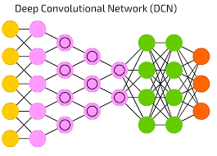
DEEP NEURAL NETWORK

Slide 8
Neural networks are functions like x1,x2,and x3 that are transformed into outputs like zl,z2 and z3.
They are transformed to outputs in shallow networks and intermediate operations called layers in deep networks.
The weights and biases change from layer to layer.
'w' and 'v' are the weights of the layers of the neural networks.
The best use of deep learning is the supervised learning problem.
We have a set of data inputs with desired set of outputs.

Slide 9
APPLICATION
Here, back propagation algorithm is applied in order to get the correct output.
The basic dataset of deep learning is the MNIST, a dataset of handwritten digits.
Convolutional neural networks can be trained with Keras.
This is done in order to classify the images of handwritten digits from this dataset.
The activation of neural network classifier produces a score.

Slide 10
The activation of neural network classifier produces a score.
To classify patients as sick and healthy, consider parameters like height, weight, body temperature and blood pressure.
A high score means patient is sick and low score means patient is healthy.
Each node in output and hidden layers has its own classifiers.
The input layer takes its inputs and passes on its scores to the next hidden layer for further activation

Slide 11

OBJECTIVE
The social network, a crucial part of our life is plagued by online impersonation and fake accounts.
According to the 'Community Standards Enforcement Report' published by Facebook on March 2018, about 583 million fake accounts were taken down just in quarter 1 of 2018 and as many as 3-4% of its active accounts during this time were still fake.

Slide 12

In this project, we propose a model that could be used to classify an account as fake or genuine. This model uses Support Vector Machine as a classification technique and can process a large dataset of accounts at once, eliminating the need to evaluate each account manually.

Slide 13

The community of concern to us here is Fake Accounts and our problem can be said to be a classification or a clustering problem. As, this is an automatic detection method, it can be applied easily by online social networks which has millions of profiles, whose profiles cannot be examined manually.

Slide 14
Naive Bayes algorithm.
Particularly since late 2016 during the American Presidential election, the question of determining 'fake news' has also been the subject of particular attention within the literature.
Conroy, Rubin, and Chen [1] outlines several approaches that seem promising towards the aim of perfectly classify the misleading articles.
They note that simple content-related n-grams and shallow parts-of-speech (POS) tagging have proven insufficient for the classification task, often failing to account for important context information.
Rather, these methods have been shown useful only in tandem with more complex methods of analysis.

Slide 15
PROPOSED SYSTEM
Classification starts from the selection of profile that needs to be classified.
Once the profile is selected, the useful features are extracted for the purpose of classification.
The extracted features are then fed to trained classifier.
Classifier is trained regularly as new data is fed into the classifier.
Classifier then determines whether the profile is genuine or fake.
The result of classification algorithm is then verified and feedback is fed back into the classifier.
As the number of training data increases the classifier becomes more and more accurate in predicting the fake profiles.

Slide 16
ADVANTAGES
The social networking sites are making our social lives better but nevertheless there are a lot of issues with using these social networking sites.
The issues are privacy, online bullying, potential for misuse, trolling, etc. These are done mostly by using fake profiles. In
In this project, we came up with a framework through which we can detect a fake profile using
machine learning algorithms so that the social life of people become secured.

Slide 17
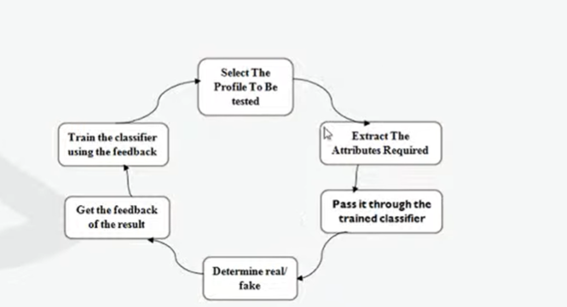
SYSTEM ARCHITECTURE

Slide 18
DESCRIPTION
Social Media Platform:
From the social networking platform, the various dataset is collected. This dataset includes attributes which are common to both human and bots. But it also includes other attributes which describes the psychological behaviour of the account holders. using which the fake human accounts can be identified from the given dataset.
Cleaning data:
Data cleansing is the process of altering data in a given storage resource to make sure that it is
accurate and correct. There are many ways to pursue data cleansing in various software and data storage architectures; most of them center on the careful review of data sets and the protocols associated with any particular data storage technology. Data cleansing is also known as data cleaning or data scrubbing.

Slide 19
TESTING THE DATA
Some test data is used to confirm the expected result, i.e. When test data is entered the expected result should come and some test data is used to verify the software behavior to invalid input data. Test data is generated by testers or by automation tools which support testing. Most of the times in regression testing the test data is re-used, it is always a good practice to verify the test data before re- using it in any kind of test.

Slide 20
CONFUSION MATRIX
Confusion Matrix is a technique for summarizing the performance of a classification algorithm. Calculating a confusion matrix can give you a better idea of what your classification model is getting right and what types of errors it is making.
True Positive Rate (TPR)=TP/TP+FN
False Positive Rate (FPR)=FP/FP+TN
True Negative Rate (TNR)=TN/FP+TN
False Negative Rate (FNR)=1-TPR
Recall- How many of the true positives were recalled (found), i.e. how many of the correct hits were also found.

Slide 21
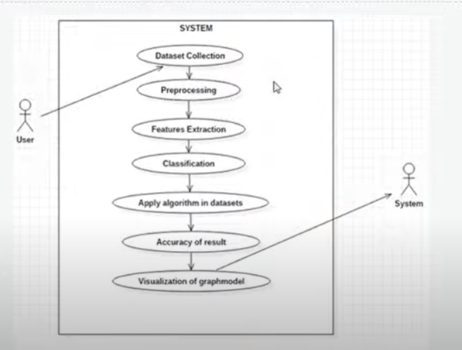
UML DIAGRAM

Slide 22
SOTWARE LIBRERIES
Python
numpy
pandas
itertools
matplotlib
sklearn

Slide 23
HARDWARE REQUIREMENT
2 GB RAM
80 GB Hard Disk Above
2GHz Processor

